Slide 1
Santander Product Kaggle set analysis
Me llamo andre johnson

Slide 2

overview
Client: banco Santander a primarily Spanish bank and a wholly owned sub of Santander group which serves over 100mln customers in spain, Uk, other parts of Europe, US, and latin America
1.5 years worth of anonymized customer data with demographic information and details on account/Product holdings
Analyzed data to classify customers and to develop a predictive model on total number of products and also monthly change in number of products

Slide 4
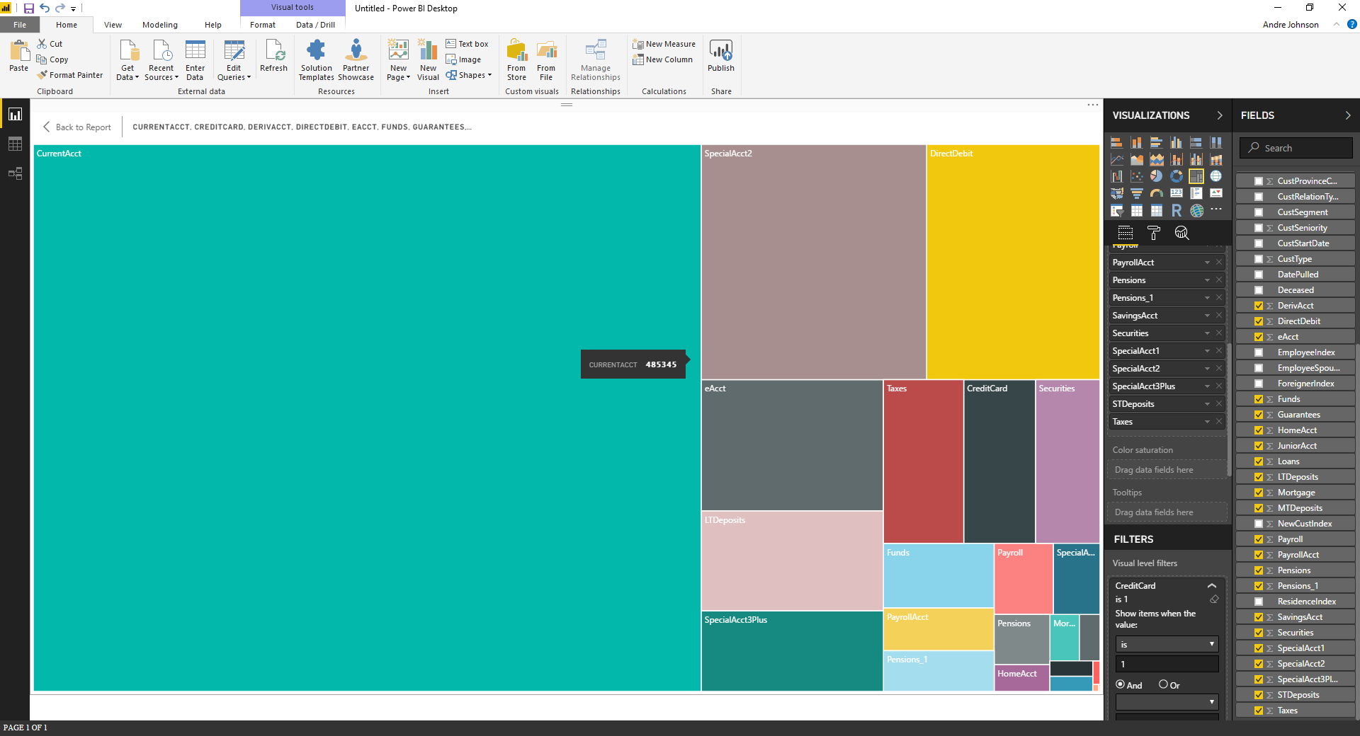
Number of Accounts by type

Slide 5
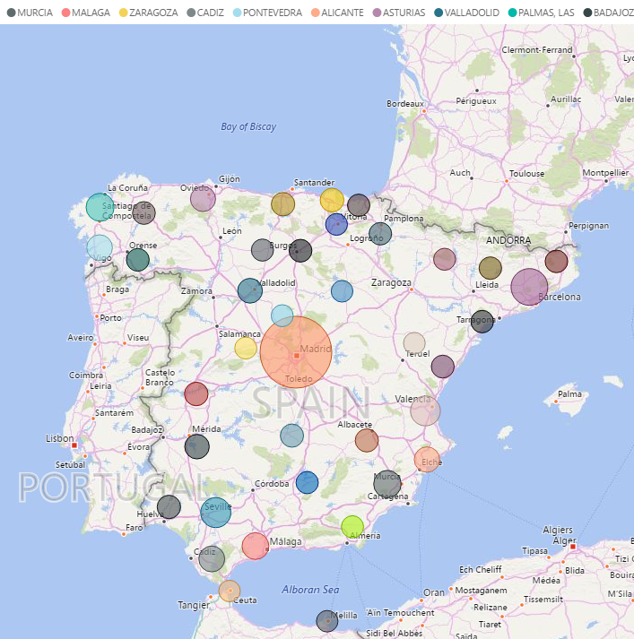
number of Current accounts by Province

Slide 6
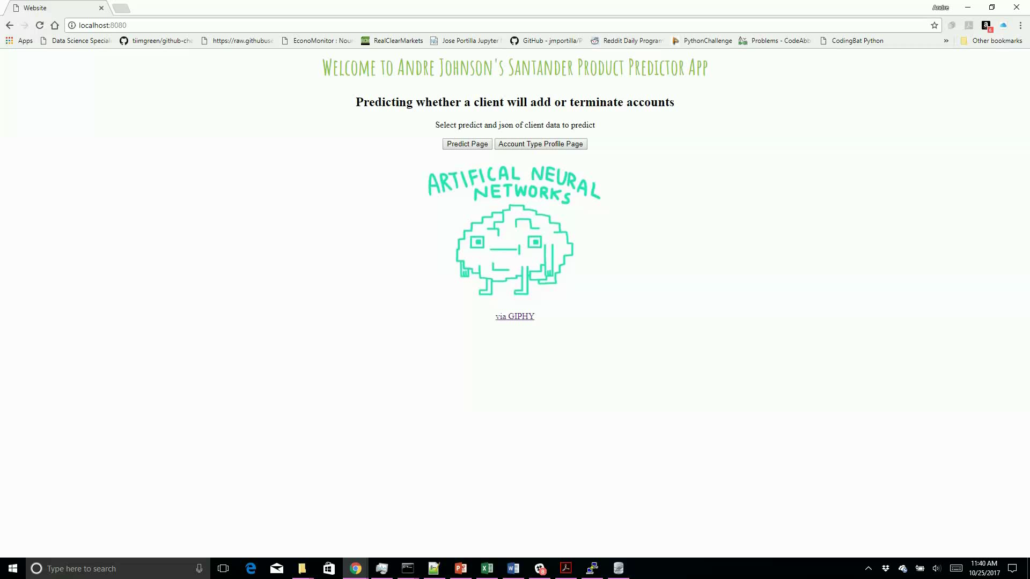


Slide 8
Predictive Model for account holders with 0, 1, 2, 3+ accounts
Model | Score
K-nearest Neighbors (K=18) | .60
Logistic Regression | .62
Decision Tree | .55
Random Forest | .54
Gradient Boosting | .59
Gradient Boosting (Grid Search) | .48

Slide 9
Predictive Model for Change in Products month over month (-1,0,1,2+)
Model | Score
K-nearest Neighbors (K=18) | .667
Logistic Regression | .679
Decision Tree | .16
Random Forest | .15
Gradient Boosting | .226
Gradient Boosting (Grid Search) | .087

Slide 10
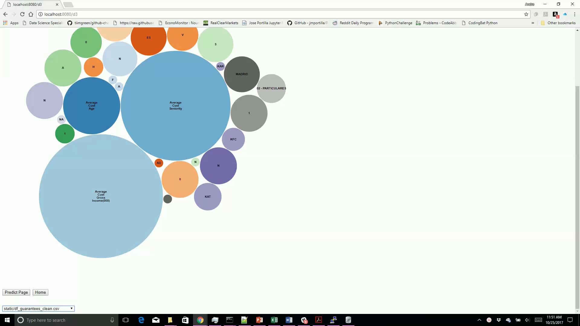

Slide 11
Conclusion and next steps
Further clean up data which would require access to source Data
Format and build on flask app to make more robust and production ready
Model per account type to predict whether client will add account type

Slide 12
Questions????

